Slide 1
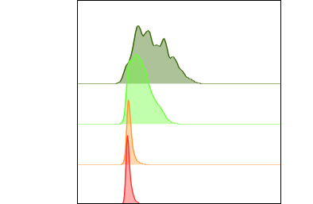
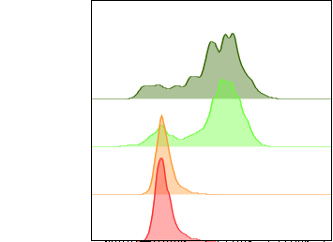
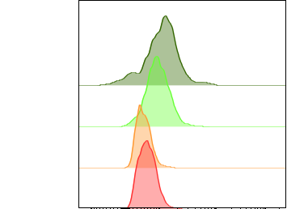
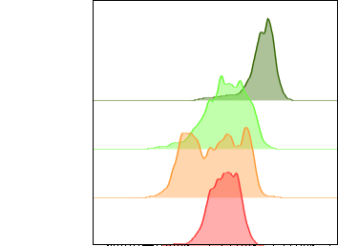
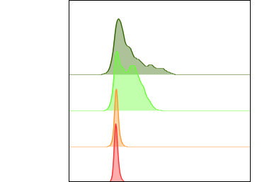
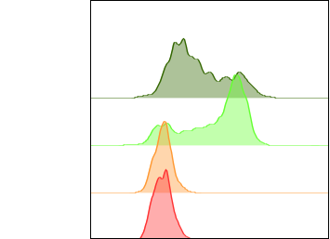
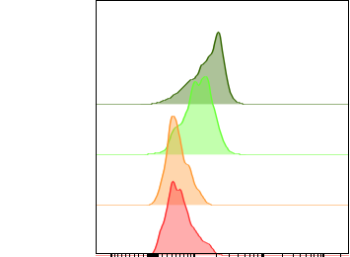

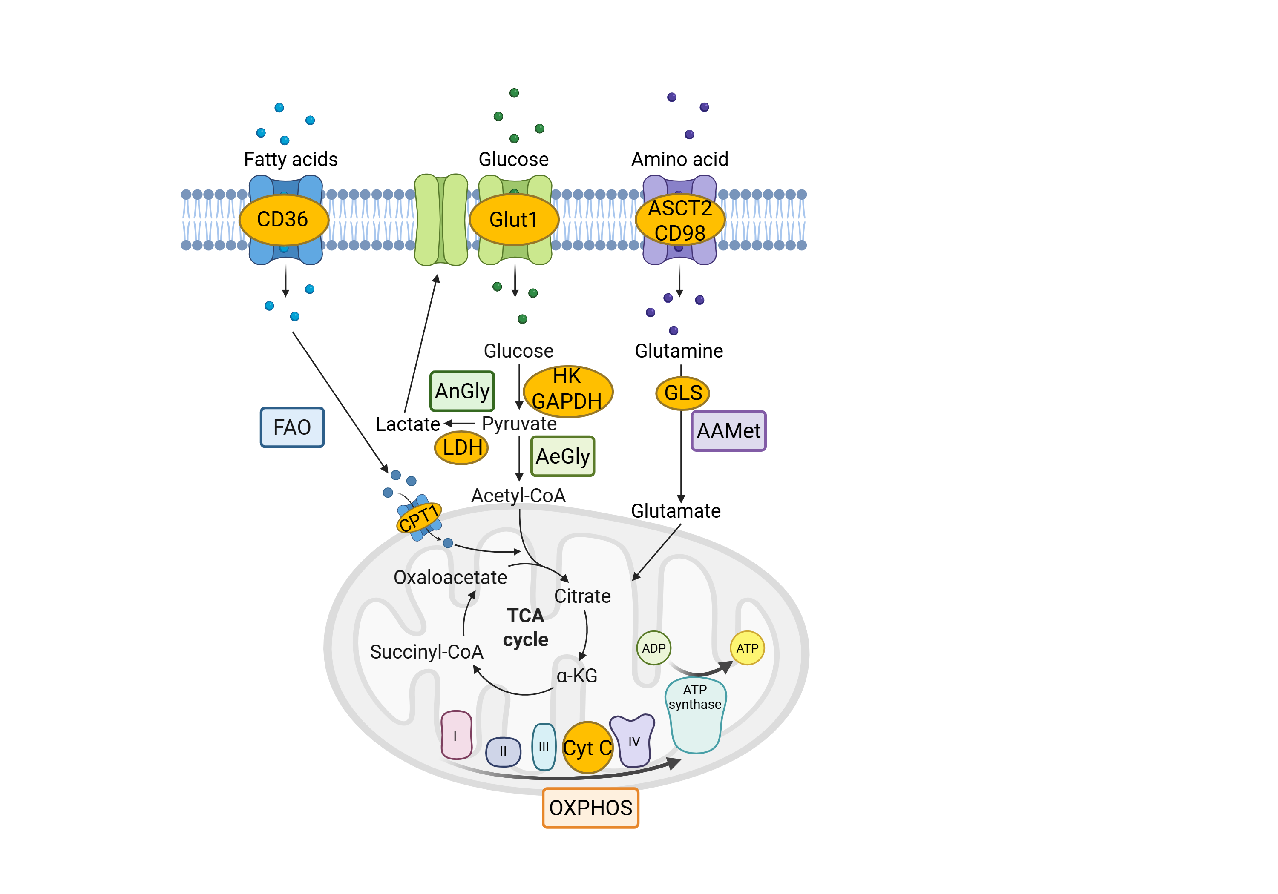
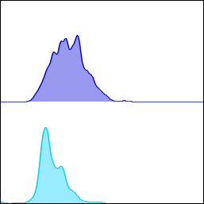
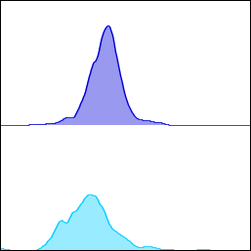
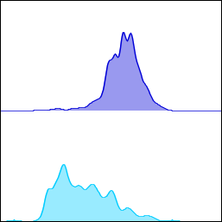
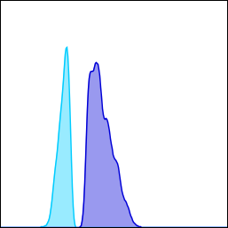
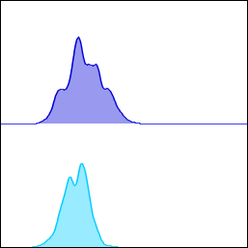
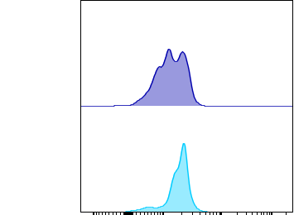
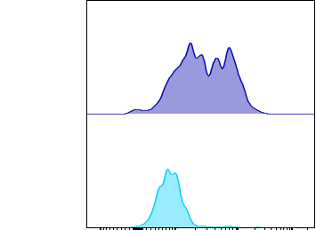
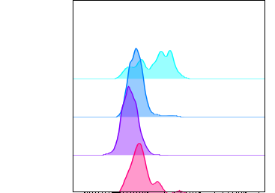
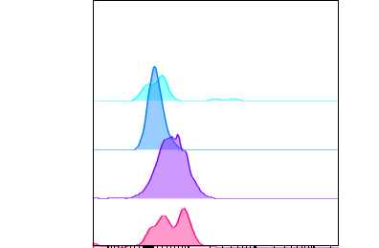
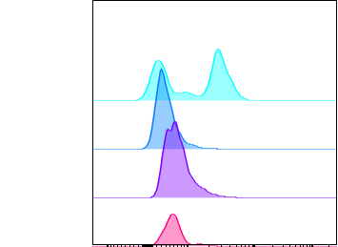
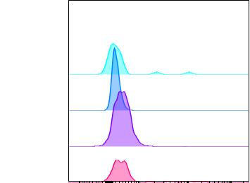
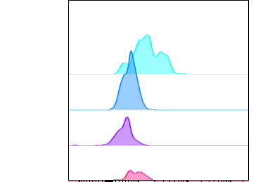

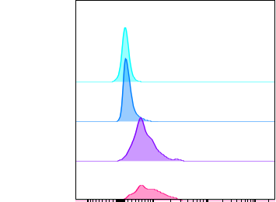
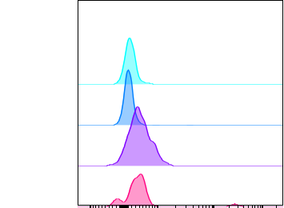

Michelle Kraft, Sophia Hahn, Dr. Luiz Machado, Dr. Katrin Vogel, Prof. Dr. Monika Brunner-Weinzierl
Experimental Paediatrics and Neonatology, University Hospital Magdeburg
Metabolic reprogramming in human T cells
Introduction
Results
T cells play a central role in the immune defense against infections and tumors. Upon activation by antigen stimulation, both CD8+ and CD4+ T cells undergo metabolic reprogramming to meet the energetic and biosynthetic demands of activation, proliferation, and function. This metabolic adaptation is essential for the survival and effector activity of CD8+ cytotoxic T cells as well as the helper functions of CD4+ T cells. However, the role of co-stimulation regarding metabolic reprogramming of T cells is not fully understood so far.
Figure 1: Schematic Representation of Metabolic Pathways
Key metabolic pathways in T cells, including fatty acid oxidation (FAO), anaerobic (AnGly) and aerobic glycolysis (AeGly), amino acid metabolism (AAMet), the TCA cycle, and oxidative phosphorylation (OXPHOS).
Figure 2: Activation of T cells changes their metabolic profiles.
Expression levels of metabolic markers analyzed via flow cytometry of one sample. Unstimulated cells (red) and cells stimulated with anti-CD3 + anti-CD28 for 10 minutes (orange), 24 hours (light green) and 48 hours (dark green).
Figure 3: T cells with low/high glucose expression differ in their metabolic pathways.
Expression levels of metabolic markers analyzed via flow cytometry of one sample stimulated for 48 hours with anti-CD3 + anti-CD28. Gating on Glut1^{low} (blue) and Glut1^{high} (violet) expressing cells.
Figure 4: Subpopulations of T cells vary in their metabolic profile.
Expression levels of metabolic markers analyzed via flow cytometry of one sample ex vivo. Gating on effector cells (CD45RA⁺CD62L⁻, pink), effector memory cells (CD45RA⁻CD62L⁻, violet), central memory cells (CD45RA⁻CD62L⁺, dark blue) and stem-like memory cells (CD45RA⁺CD62L⁺CD95⁺, light blue).
Glut1 CD98 CPT1A CytC
CD8⁺ CD4 ⁺
Unstimulated
10 min
24 h
48 h
LDH CPT1A CD98
Glut1^{high}
Glut1^{low}
CD4⁺
CD8⁺
GAPDH LDH CD98 CD36
CD8⁺ CD4 ⁺
T_{EFF}
T_{EM}
T_{CM}
T_{SCM}
Methods
Isolation of PBMCs from LSR cones (Red Cross blood donation center in Dessau), Pancoll density gradient centrifugation
Stimulation of 2x10⁵ PBMCs with 1 µg of soluble anti-CD3 and 2 µg of soluble anti-CD28 for 10 minutes, 24 hours, and 48 hours
Surface and intracellular flow cytometry
Conclusion
Further research
Investigation of the role of T cell costimulation on metabolism via SLAMF7
Comparison to model disease Rheumatoid Arthritis (Study: RheumaMining with working group Feist and Spiliopoulou)
Deletion of SLAMF7 by CRISPR/Cas9, Seahorse real time assays, qPCR
Metabolic reprogramming is detectable at 24 hours following T cell activation
Elevated Glut1 expression is associated with a prevalence of increased CD98 levels, indicating enhanced amino acid metabolism
T cells subsets vary in their metabolic profile, reflecting functional heterogenity
Conflict of interest declaration
The authors declare that they have no conflict of interest

